Slide 1
Power Query (M):
Web scraping using Web.BrowserContents
and Html.Table

Slide 2
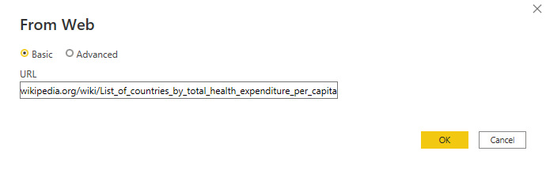
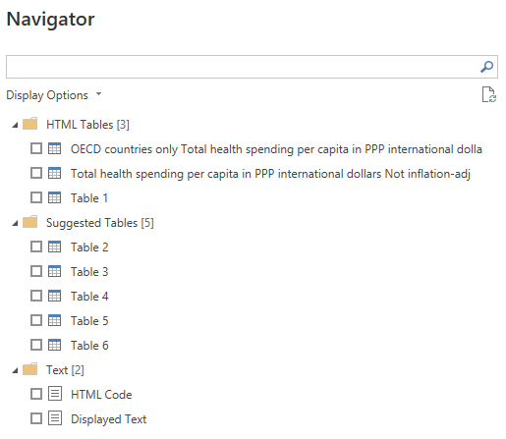
We can easily extract data from a webpage
Using Get data>Web

Slide 3
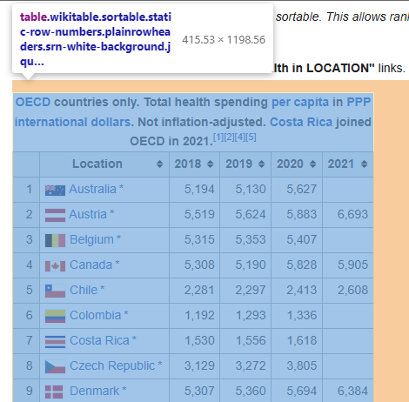
If the page includes <table> elements, they are listed under HTML tables

Slide 4
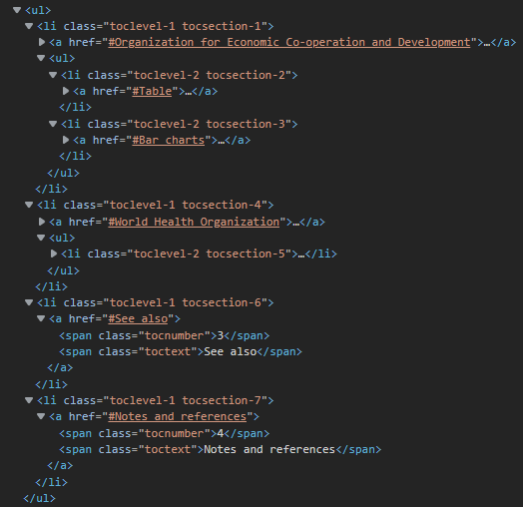
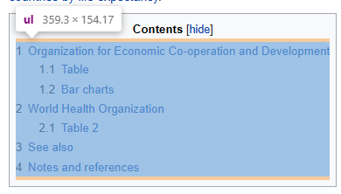
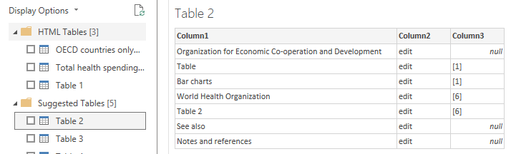
PQ will also try to detect other structured data
Here, the table-of-contents is an unordered (bulleted) list - <ul>. PQ has suggested this as Table 2

Slide 5
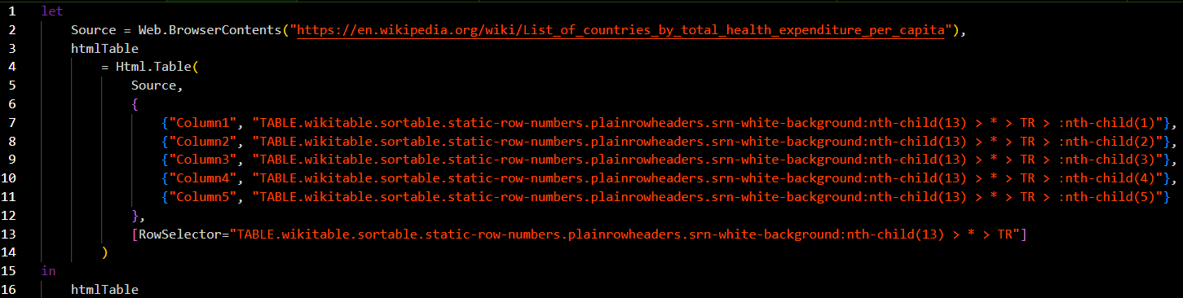
When we load a table, PQ generates some code
Web.BrowserContents downloads the HTML from the page
Html.Table extracts data from the downloaded HTML

Slide 6
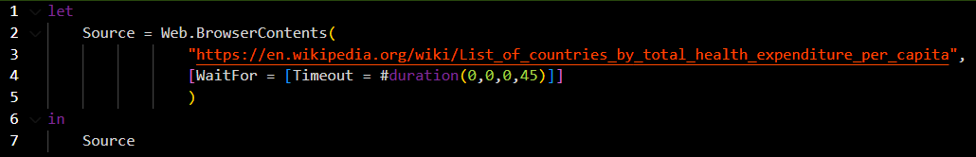
If the page has a lot of content, we can choose to ask Web.BrowserContents to wait for it to load completely before downloading
The first parameter is the URL of the page
The second (optional) parameter can be a record with one field – WaitFor, which is itself a record with one or two fields – either Timeout (duration) or Selector (text) or both

Slide 7

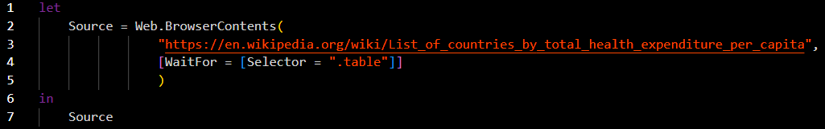
There are two options for WaitFor
Selector must be a valid CSS selector text.
See CSS Selectors Reference (w3schools.com) for details
WaitFor is a record with one or two fields – either Timeout (duration) or Selector (text) or both
Give the function 45 seconds to download the complete HTML of the page
Wait for the element with class attribute “table” before finishing the download

Slide 8
Html.Table extracts information from valid HTML text
The first parameter of Html.Table is a valid HTML text, often (but not always) derived from Web.BrowserContents
The 3rd param, which is optional on one-column tables, is a one-field record – RowSelector, which is a CSS Selector used to identify each row in the table
The second parameter is a list of lists.
Each sub-list takes the form
{
column name,
CSS selector,
(optional) function to process the element attributes
}

Slide 9
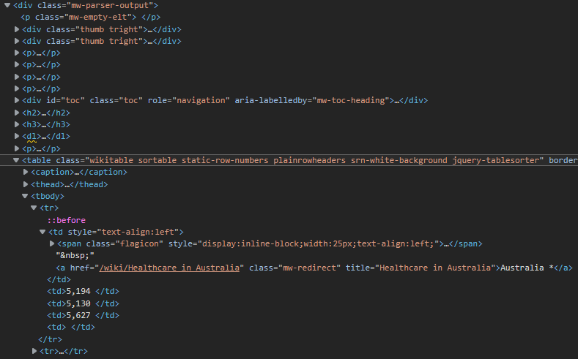
RowSelector tells Html.Table which elements to use
Select all <TR> elements whose parent is any element - * - which has a parent <table> element with class attribute
wikitable sortable static-row-numbers plainrowheaders srn-white-background
which is the 13th child of its parent
Parent
13th child of parent
Table rows <tr>

Slide 10
OK, take a breath…
Most of the time, Power Query is smart enough to find the correct elements for you and you won’t need to worry manually typing in these CSS Selectors
HUGE RELIEF.

Slide 11

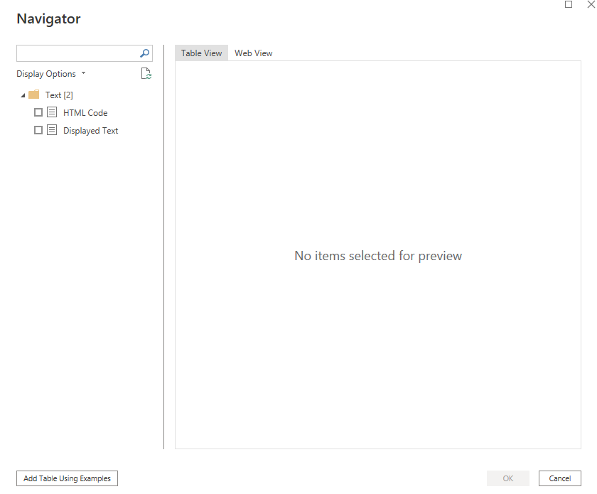
But what if all you see in the Navigator pane is this?
Power Query is great, but sometimes the website you want to scrape isn’t so easily parsed.
Sometimes no tables can be found.
We can either Add Table Using Examples or load the HTML code and build Html.Table by hand

Slide 12
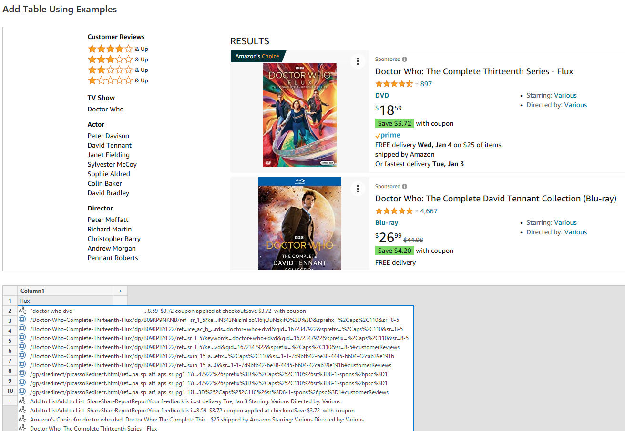
‘Add Table Using Examples’
i) try to find the right elements
With ‘Add Table Using Examples’, we try typing in a column and Power Query will attempt to locate an element in the page that contains what we’ve typed.
We select the item in the list that best matches what we’re looking for

Slide 13
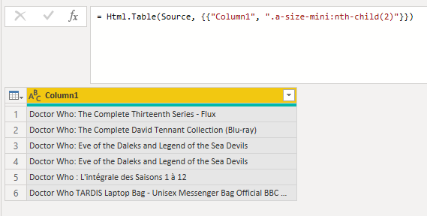
‘Add Table Using Examples’
ii) review the results
We can then review the selector and the results
In this case, “Add Tables Using Examples” has used the wrong selector.
The list of titles is too short.

Slide 14
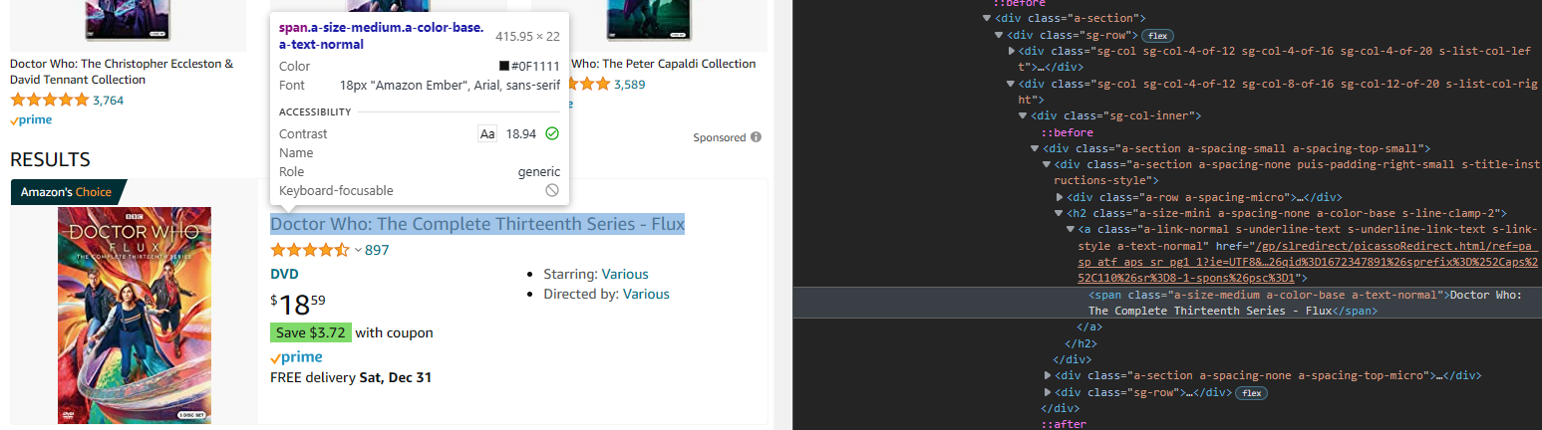
Build Html.Table manually
i) find the correct element using “developer tools”
If we use the browser’s developer tools, we can review the elements on-screen and select the element whose class attribute we want
span.a-size-medium.a-color-base.a-text-normal

Slide 15
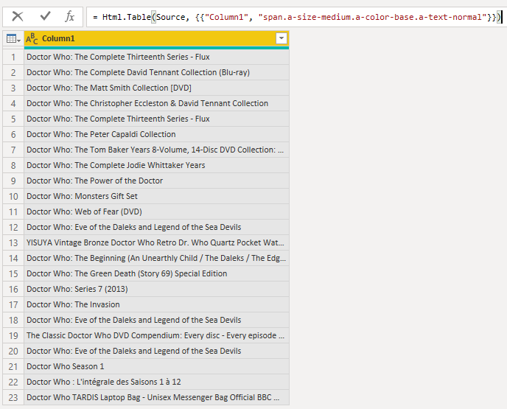
Build Html.Table manually
ii) use it as the CSS Selector for the table column
span.a-size-medium.a-color-base.a-text-normal
By editing the CSS Selector for column1, We’ve extracted the title from each matching element

Slide 16
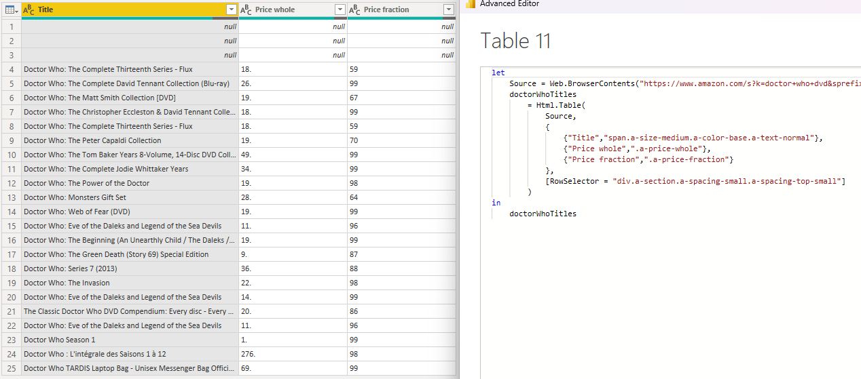
‘Build Html.Table manually
iii) add additional columns
Each page element has a tag and usually a class attribute. Understanding CSS Selectors is critical to successful web scraping
If we have more than one column, we must also have a RowSelector

Slide 17
Web scraping with Power Query - Takeaways
In Power Query, most web-scraping can be done with very little effort using Get Data>Web
In some cases, you may need to inspect the HTML using your browser’s developer tools
A good understanding of CSS Selectors will help you be more successful with parsing HTML. CSS Selectors Reference (w3schools.com) is a good resource for this
Be sure of the legality of scraping data from the websites you want to interact with

Slide 18
For an example walkthrough, continue reading ➔

Slide 19
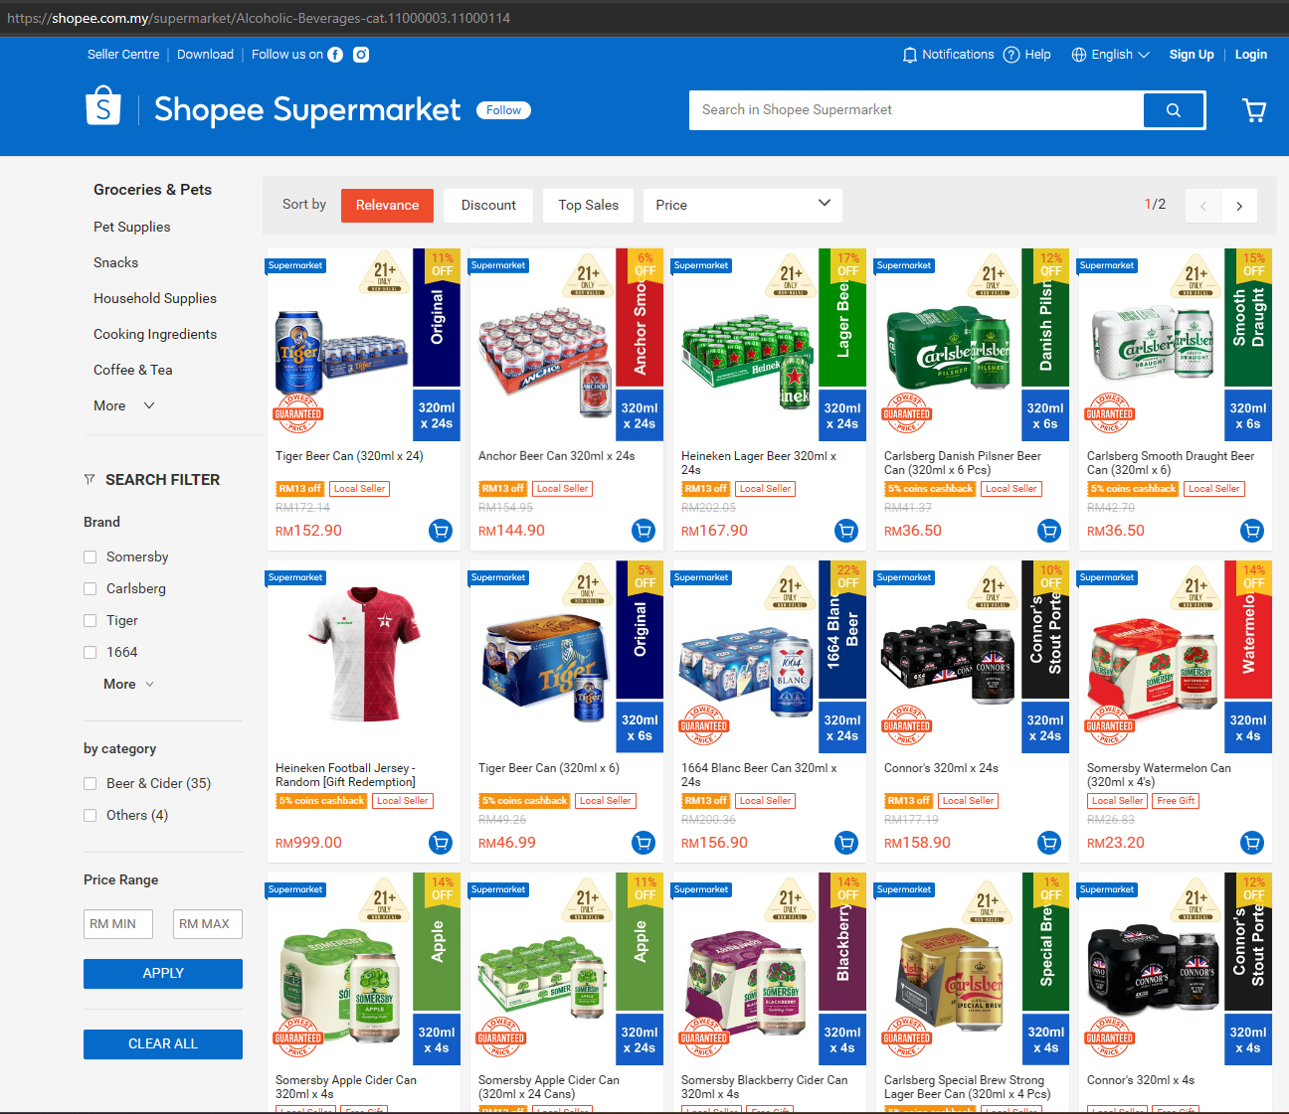
Shopee is a popular online supermarket in several Asian countries
This search for alcoholic beverages has 25 results on the first page. When initially loading, 15 are visible in the window.

Slide 20
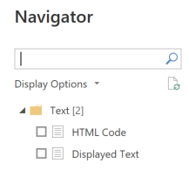

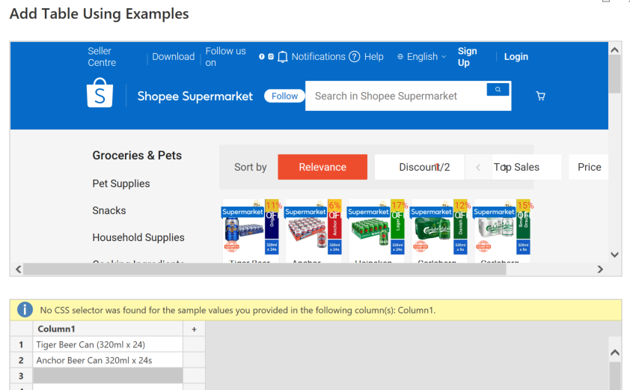
I tried to get the brand details from the page
The Navigator showed me there were no HTML tables and no Suggested tables
“Add Table Using Examples” couldn’t find a CSS Selector for the brand

Slide 21
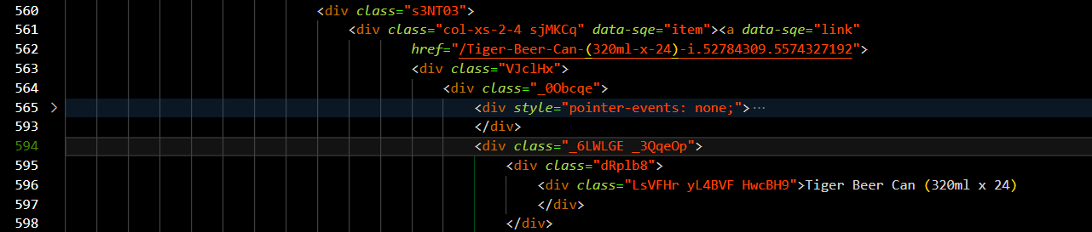
I used the developer tools in my browser to inspect the HTML of the page
I found the text “Tiger Beer Can (320ml x 24)” in the div element with class attribute
LsVFHr yL4BVF HwcBH9
The CSS Selector
“.LsVFHr.yL4BVF.HwcBH9”
will find all such elements on the page

Slide 22
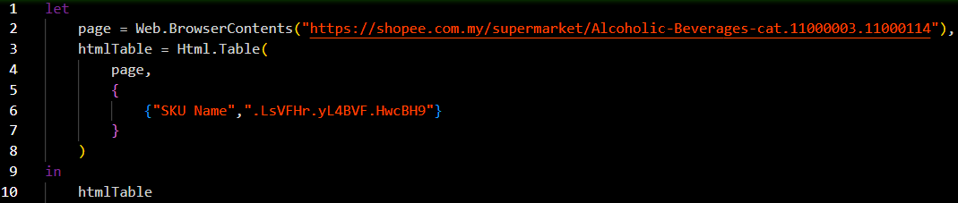
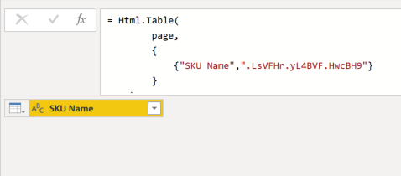
I used the Selector to try to extract just the brand name from the page
The first attempt returned no data!

Slide 23
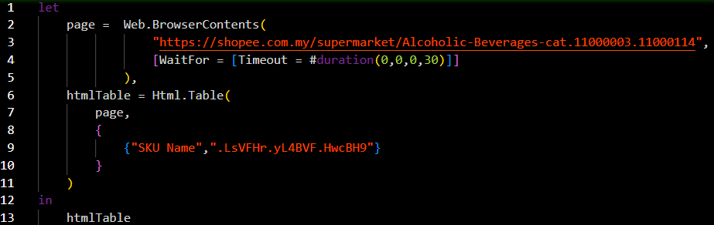
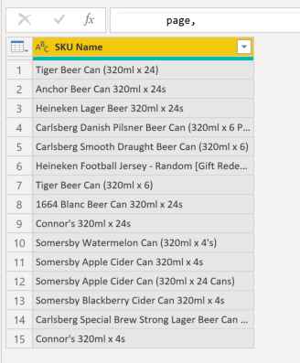
I added a Timeout to Web.BrowserContents to give the page more time to fill the elements
Even though there were 25 brands on the page, the query only returned 15

Slide 24
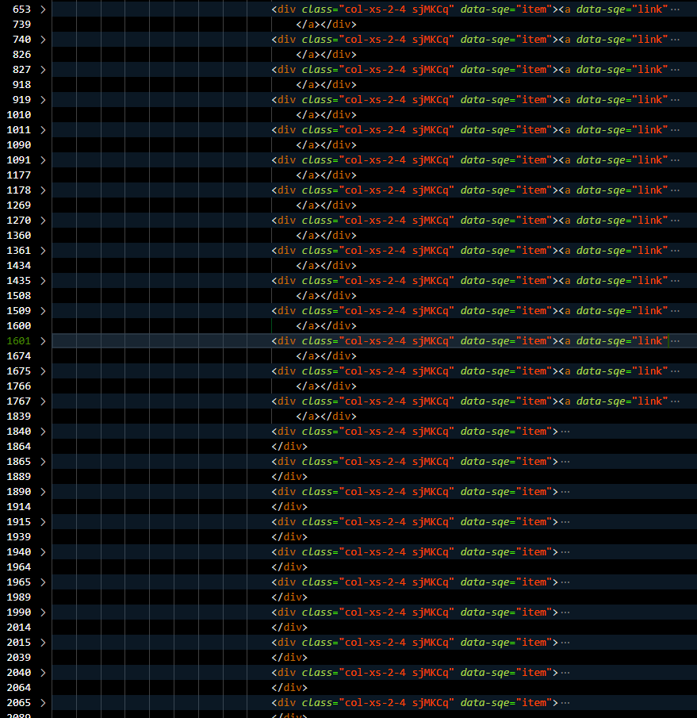
I found that the page had a script to fill the first 15 brands when the page loads. The rest are filled when the window is scrolled!
The first 15 brands were populated with data
The remaining 10 were populated with placeholders and didn’t have all the child elements

Slide 25
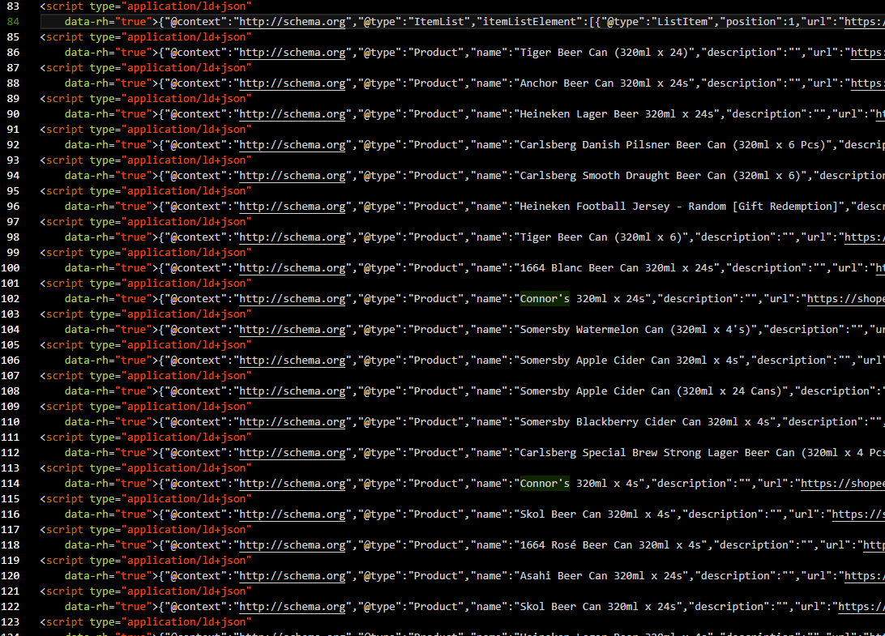
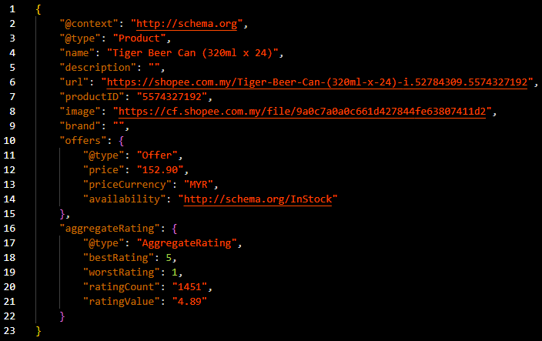
I found that all data for the page was in script elements containing JSON documents

Slide 26
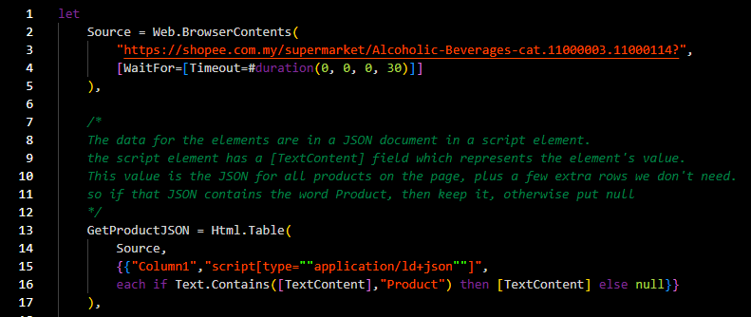
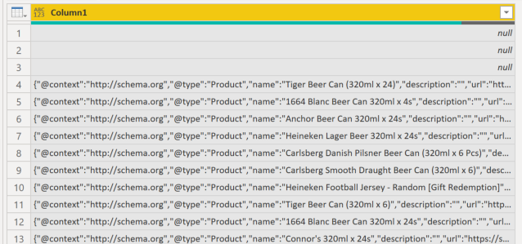
I changed Html.Table to extract the JSON from those elements
This CSS selector means
select the elements with a script tag and an attribute called type whose value is “application/ld+json”
If the [TextContent] attribute of the returned element contains the word Product, then put the whole JSON, otherwise put null

Slide 27
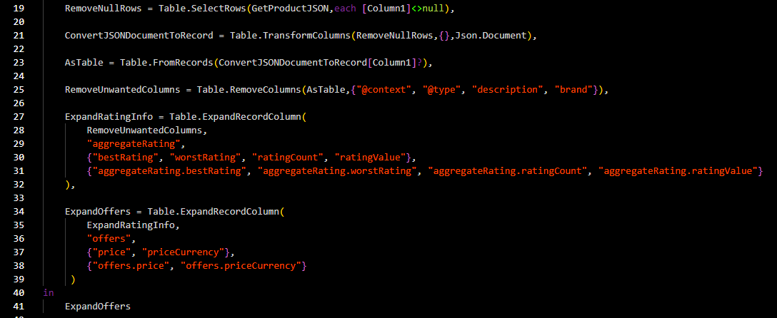
Then it was just a matter of extracting the data using UI–equivalent commands

Slide 28
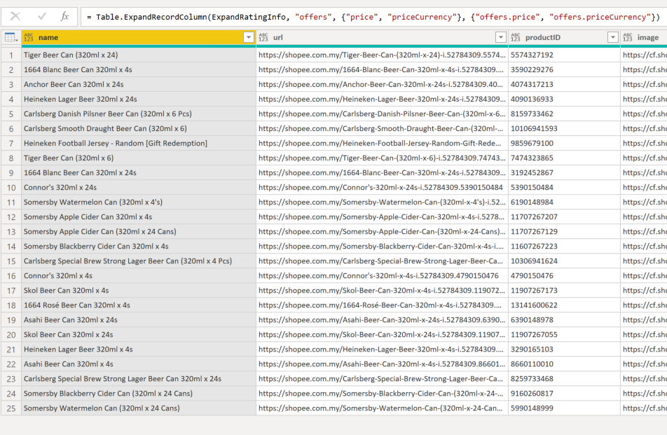

The result was all 25 brands from the first page of search results

